Slide 1


M.Tech/MCA Program
Advanced Industry Integrated Programs
Jointly offered by University and LTIMindTree
Review III
Project Title
EduTrace: Exam-Aware Personalized RAG Assistant
M.Tech / B.S. Abdur Rahman Crescent Institute of Science and Technology/T9961
Team Member
SNEHA SHREE S
CRESCENT 2025-27
Knowledge partner | Implementation partner

Slide 2
Introduction
AI-powered learning platform for personalized academic guidance.
Analyzes learner performance and academic data.
Identifies weak topics and learning gaps.
Uses educational resources such as syllabus, notes, and study materials.
Uses RAG (Retrieval-Augmented Generation) to retrieve relevant information.
Provides personalized concept explanations.
Generates examples, key points, and important questions.
Supports both concept understanding and exam preparation.
Helps learners follow a focused and effective learning approach.

Slide 3
Objective
Analyze learner academic performance and assessment data.
Identify weak subjects, topics, and learning gaps.
Provide personalized concept explanations and examples.
Retrieve relevant information from syllabus, notes, and study materials.
Generate important and exam-oriented questions.
Provide an interactive AI learning assistant.
Help learners focus on areas that require more attention and practice.
Create a unified and intelligent personal learning workspace.

Slide 4
Methodology/Modeling Plan
Module | Function
Dashboard | Provides an overview of learner progress
Performance Analyzer | Analyzes marks and identifies performance patterns
AI Assistant | Answers academic questions and explains concepts
Knowledge Vault | Stores and manages learning documents
RAG Engine | Retrieves relevant information from the knowledge base
Topic Analyzer | Identifies weak and important topics
Exam Preparation | Supports question-based exam preparation
EduBot | Provides interactive AI-based concept teaching
Analytics | Displays learning insights and performance trends

Slide 5
Scope
Claim Management
New claim submission.
Claim ID generation.
Claim status tracking.
Document Management
Upload and verify medical documents.
Process bills, reports and supporting records.
AI Analysis
Eligibility assessment.
Fraud-risk analysis.
Claim information analysis.

Slide 6
Problem Statement
Traditional learning systems often provide generic study materials and basic performance reports without adapting to the individual learner. Students may know their marks but may not know which concepts they are weak in or what they should study next. General AI assistants can explain concepts, but they may not use the learner’s academic performance or trusted study materials as context.
Therefore, there is a need for an integrated system that combines performance analysis, knowledge retrieval, personalized AI assistance, and exam preparation in one platform.

Slide 7
Approach/Algorithms/Tools
Approach | Algorithms / Techniques | Tools
Data Preprocessing | Cleaning & Normalization | Python, Pandas, NumPy
EDA | Statistical Analysis | Matplotlib
Performance Analysis | Score & Accuracy Analysis | Python
Weak Topic Detection | Topic-wise Analysis | Pandas
Document Processing | Text Extraction & Chunking | PDF/DOCX Processing
Semantic Retrieval | Embeddings & Similarity Search | Vector Store
Knowledge Retrieval | RAG | Python
AI Generation | Large Language Model | Groq API
Backend Development | REST API | FastAPI
Frontend Development | Component-Based UI | React.js

Slide 8
Findings & Results
Performance analysis successfully identifies strong and weak learning areas.
Topic-wise analysis helps determine accuracy and learning gaps.
The knowledge base provides relevant educational context for AI responses.
RAG enables the assistant to generate responses based on retrieved learning content.
The AI assistant can provide concept explanations, examples, key points, and exam-oriented questions.
Combining performance data with AI assistance provides more personalized learning support.

Slide 9
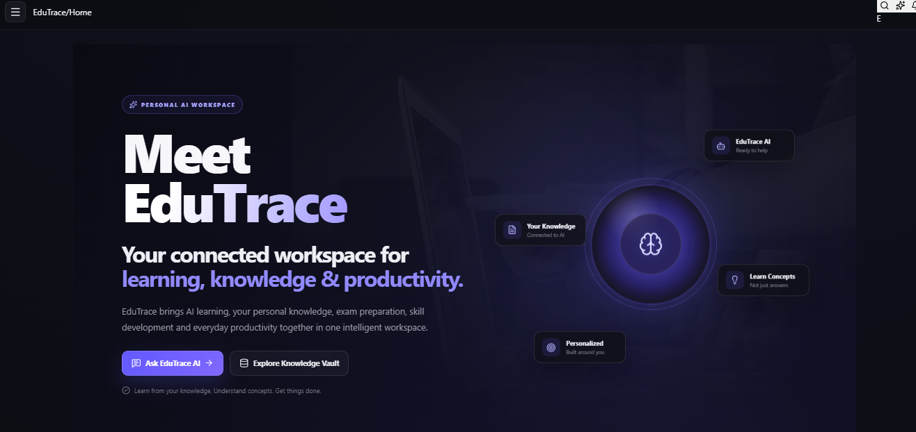
OUTCOME

Slide 10
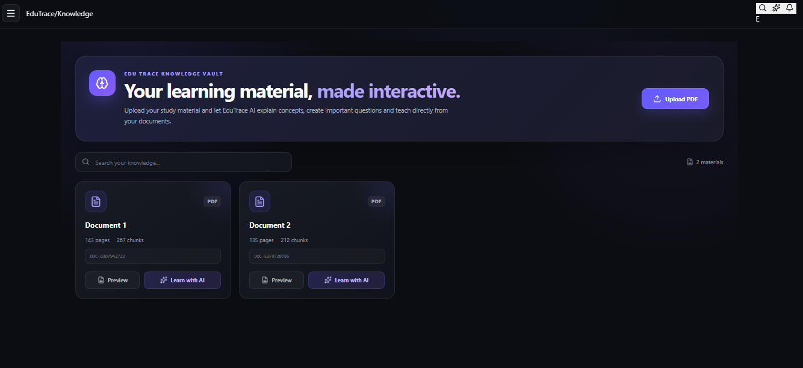

Slide 11
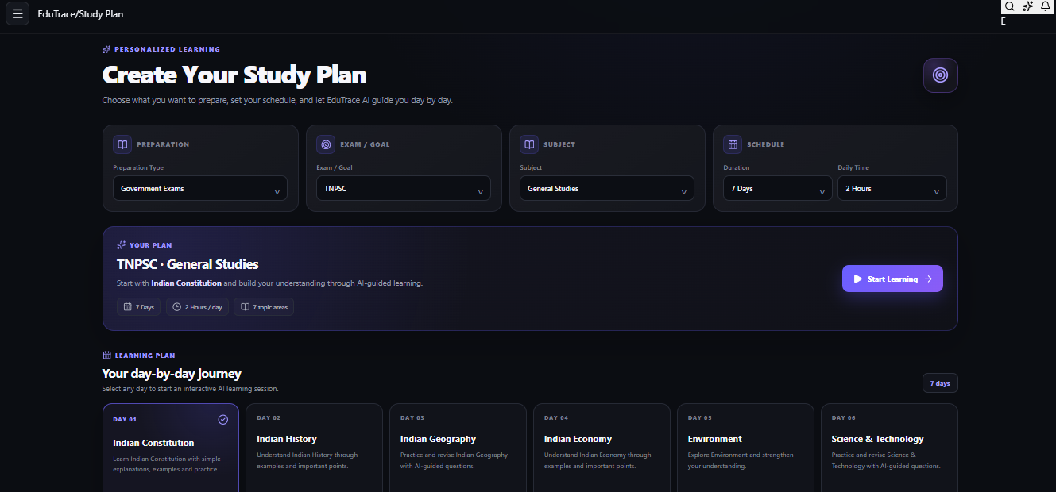

Slide 12
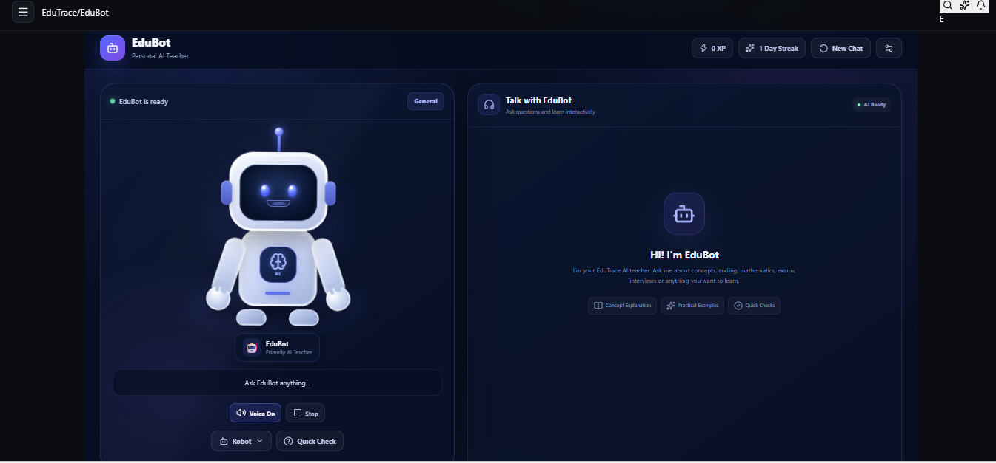

Slide 13
Conclusion
EduTrace demonstrates how AI, performance analytics, and RAG-based knowledge retrieval can be combined to create a personalized learning environment. The system identifies learner-specific weak areas and provides targeted academic assistance instead of relying only on generic content. By connecting academic performance with trusted educational resources, EduTrace helps learners understand concepts, identify what to study, and prepare more effectively for examinations.
EduTrace transforms academic data into personalized learning guidance

Slide 14
ACKNOWLEDGEMENT
I sincerely thank LTM and L&T EduTech for providing the necessary infrastructure, laptop, training room, ID card, and the valuable two-month opportunity to enhance my technical skills through practical project development.
I express my special gratitude to Dr. Ganesh for his continuous guidance, valuable suggestions, and support throughout the project. I also extend my sincere thanks to the Classroom Managers for their daily monitoring, coordination, and assistance in resolving various issues.
Finally, I would like to express my special thanks to Mr. Jayakanthan, Manager – Delivery Operations, L&T EduTech, for his encouragement, continuous support, and for providing me with this valuable opportunity to develop my technical and professional skills.

Slide 15
References
Lewis, P. et al. — Retrieval-Augmented Generation for Knowledge-Intensive NLP Tasks, NeurIPS, 2020.
Vaswani, A. et al. — Attention Is All You Need, NeurIPS, 2017.
Pedregosa, F. et al. — Scikit-learn: Machine Learning in Python, Journal of Machine Learning Research, 2011.
McKinney, W. — Python for Data Analysis, O’Reilly Media.
FastAPI Documentation — Backend API development framework.
React Documentation — Frontend development framework.
Groq API Documentation — LLM inference and AI integration.
Relevant educational datasets used for academic performance and topic analysis.

